Slide 1
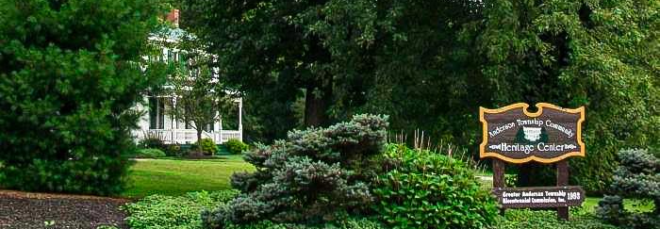
Heritage Arboretum Development Project-2
GROUP-1
Bothsa, Indrani
Saraswat, Gaurav
Singh, Neha
Wadhwa, Vaishnavi Gopal
07-09-2024

Slide 2
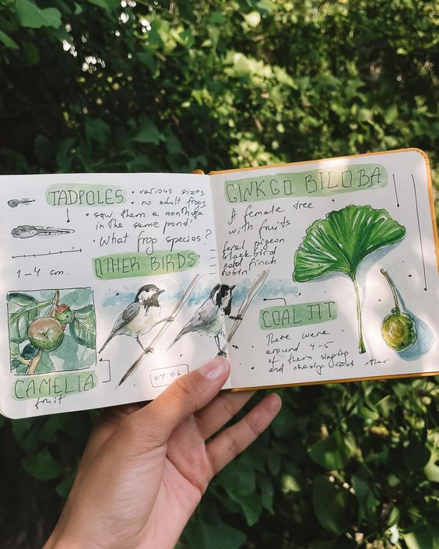
AGENDA
Decision Types & Responsibility
Agile Effectiveness
Communication Challenges
Stakeholder Personas
Comprehensive Backlog
Release Prioritization (MoSCoW )
Order of Activities
Top Stories Selection
Work Estimation
Conclusion

Slide 3

Decision Types & Responsibility
Tree Species Selection
Budget Allocation
Planting Schedule
Volunteer Coordination
Educational Events
Maintenance Plans
Partnership Development
Information Updates and Signage
Scope Adjustments
Stakeholder Interaction Improvement

Slide 4
Agile Effectiveness
Simplicity
Value
Feedback
Adapt
Collaboration
Transparency
Incremental Progress
Adaptive Planning
Educational Outreach
Volunteer Engagement

Slide 5

Communication Challenges
Challenges:
Volunteers limited availability
Reduced social interactions due to COVID
Delay in prompt feedback from team members
Solutions:
Virtual meeting tools
Regular meetings and instant messaging
Assign communication coordinator for a major task

Slide 6

Stakeholder Personas
Sarah, Local Teacher: (34 yrs.)
Enhances her curriculum with real-world examples.
John, Township Maintenance Supervisor: (45 yrs.)
Maintains a balance between project benefits and resource allocation.
Lisa, Local Resident: (28 yrs.)
Strengthens community ties and promotes local engagement.
Mike, Township Trustee: (50 yrs.)
To see the arboretum become a point of pride for the township..

Slide 7
Comprehensive Backlog
Notes:
A backlog is a changing list of requirements based on the customer's needs. The backlog is not a to-do list; rather, it is a wish list of all the desired features for the product.

Slide 8
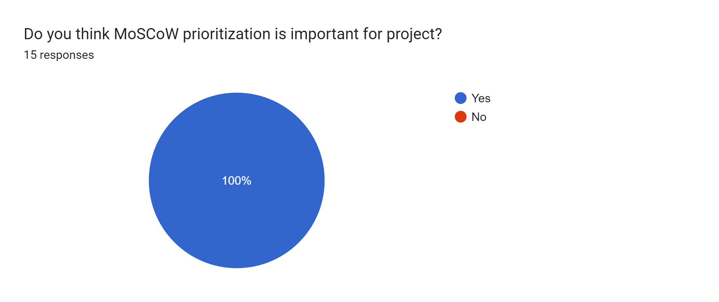
Release Prioritization (MoSCoW )

Slide 9
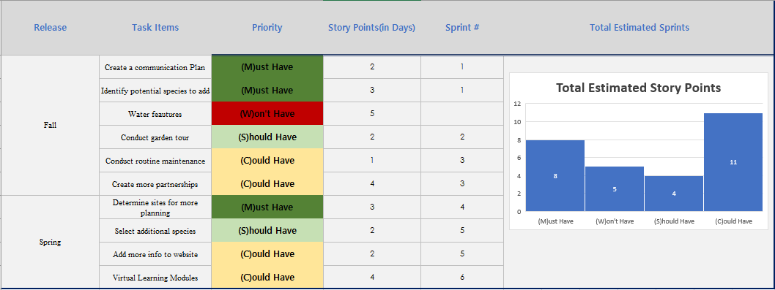
Release Prioritization (MoSCoW )

Slide 10
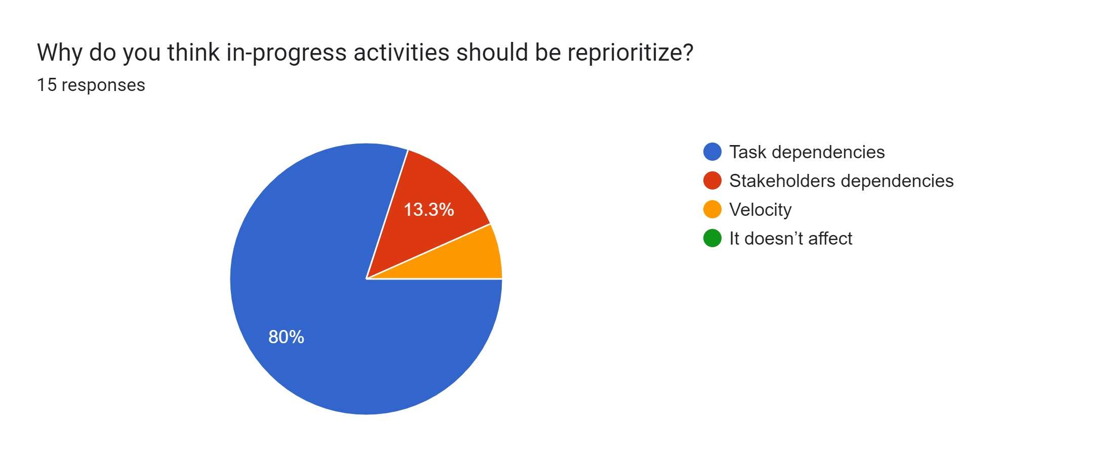
Order of Activities

Slide 11
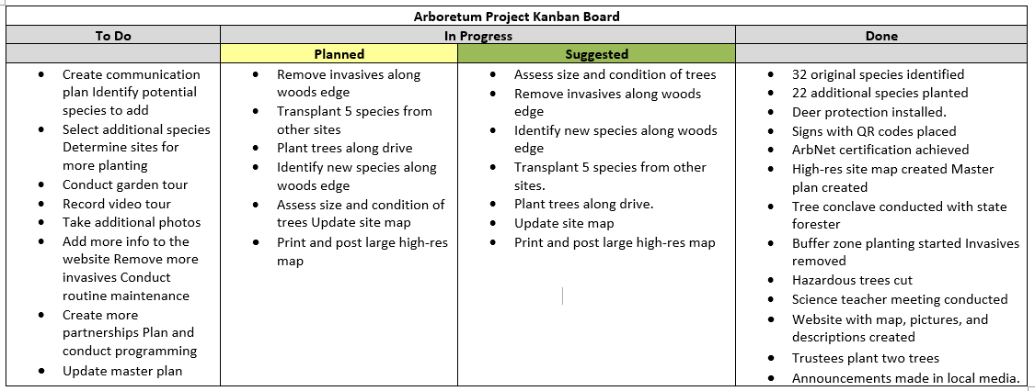
Order of Activities

Slide 12
Top Stories Selection
User Story ID | User Stories | Reason To Include
HAD001 | Create a Communication Plan. | Effective communication must be established if the project is to succeed. It guarantees that all stakeholders and team members are informed and on the same page.
HAD002 | Identify Potential Species to Add. | Planning and growing the arboretum depend on this. It serves as the foundation for choosing and introducing new species.
HAD003 | Determine Sites for More Planting | It is essential for planning and coordinating the planting operations.
HAD004 | Select Additional Species | Reassures adherence to the project's goal.
HAD005 | Conduct Garden Tour | Demonstrates advancement and involves the community. This may facilitate feedback-gathering as well as community interest and support.

Slide 13
Work Estimation
Evaluate the Team's the capacity
Divide Up the Tasks
Calculate the Velocity
Effort Estimation
Capacity Planning
Daily Stand ups / Internal Review:
(Thompson. K, 2024, para. 12-13).

Slide 14
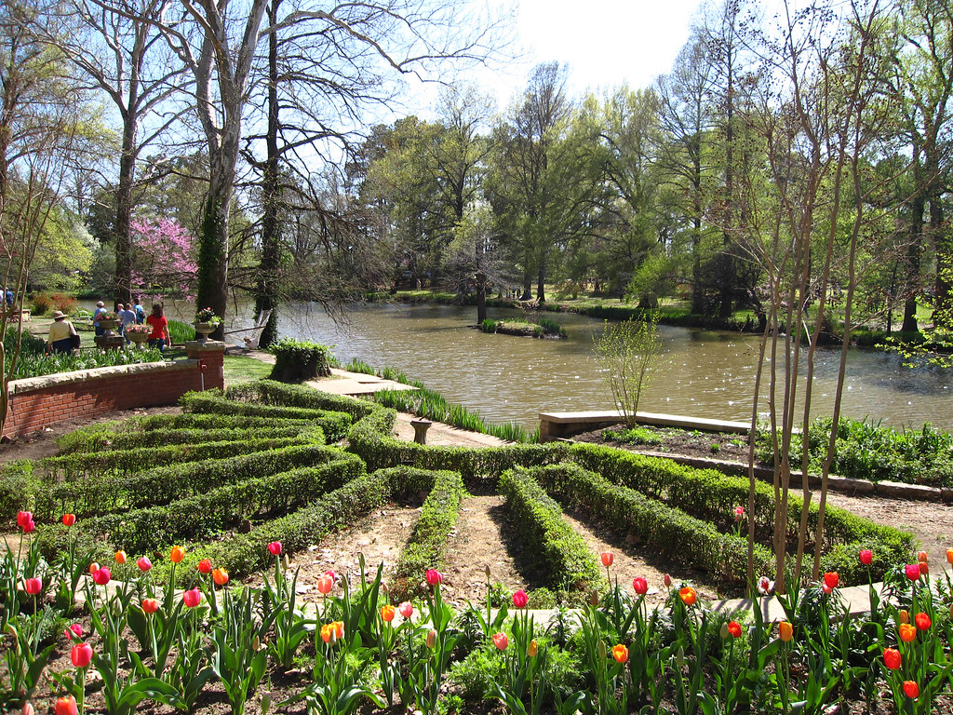
Conclusion
The Heritage Centre's attraction and instructional value were increased when the Heritage Arboretum Development Project attained Level One Arboretum classification. By using an Agile methodology, the project promoted community involvement in environmental education and green space preservation, enhanced rental possibilities, and iterative planning and communication among stakeholders.

Slide 15
References
Conestoga College. (2024). Heritage Arboretum Development Project Part 2.pdf
https://conestoga.desire2learn.com/d2l/common/viewFile.d2lfile/Database/MTM5MzEyNTkx/Heritage%20Arboretum%20Development%20Project_Part%202.pdf?ou=1123618
Thompson, K. (2024). How to Estimate Capacity for Work in Agile Teams. cprime
https://www.cprime.com/resources/blog/how-to-estimate-capacity-for-work-in-agile-teams/#:~:text=Get%20the%20availability%20and%20time,the%20capacity%20in%20person%2Ddays.
Wadhwa. V, Singh. N. (2024). PM_GROUP-1: Survey form. Google forms
https://forms.gle/Ly9bteiDxpi68zrD7

Slide 16

Thank you for listening.
Your time and interest mean a lot to us.

